Slide 1

Design and Implementation of AI Security Scheme for Next Generation Autonomous Vehicles
Mohamed Saied
Under Supervision of
Prof. Dr Hoda Korashy
Dr Khaled Youssef

Slide 2
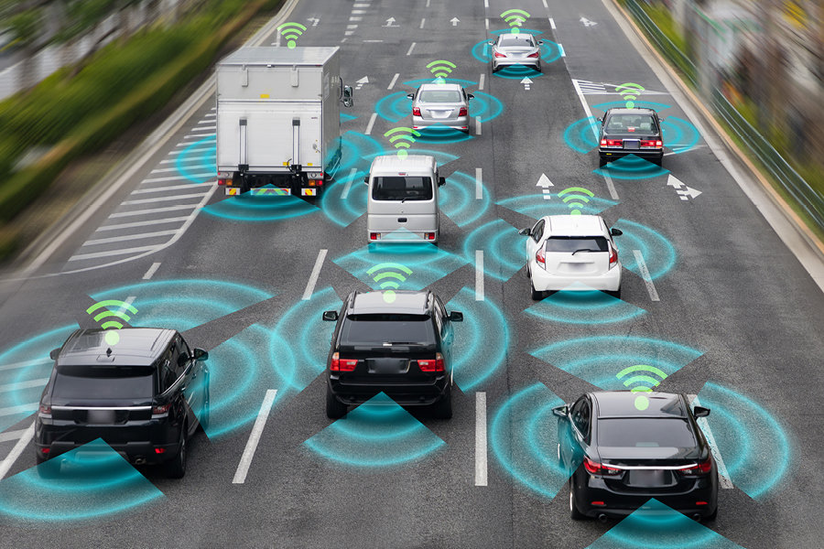
Connected Vehicles
Vehicles on the road exchange basic safety messages among each other to avoid collision.
This happens through a wireless broadcasting protocol called Dedicated short range communication(DSRC).
Which increases vehicles vulnerability.
Our goal to make the road more safer and increase Car security.

Slide 3
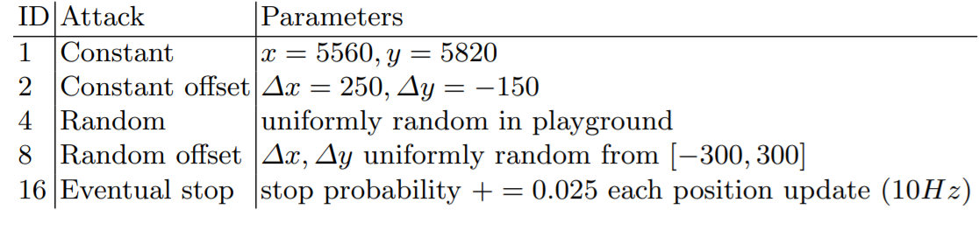
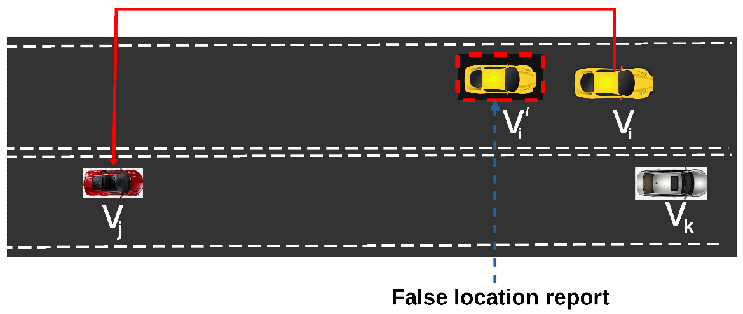
Types of Attack
The Veremi dataset demonstrate 5 types of attacks.

Slide 4
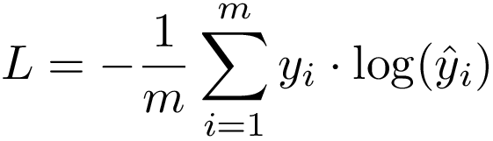
Proposed Algorithm
LSTM is used with 12 inputs and 2 outputs
LSTM Layer with 100 units with tanh activation
And dense layer with 2 outputs and sigmoid activation
And one output layer
Objective function is cross entropy
Cross validation 80% training 20% testing

Slide 5
Proposed Approach
Input Dataset to Dataframe
CrossValidation to split dataset into train and test
One Hot Encode for Labels
Define LSTM Model Architecture
Convert Model to C/C++ Array
Test & evaluate Model
Train Model

Slide 6
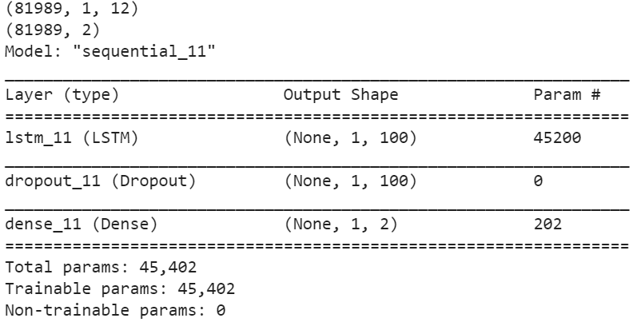
LSTM Architecture

Slide 7

Why LSTM?
Long short Term Memory Model
To keep tracking the history we need long term memory
RNN has the problem of vanishing gradient

Slide 8
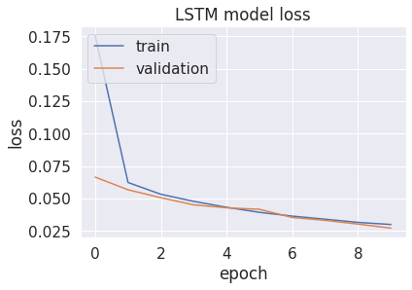

Slide 9
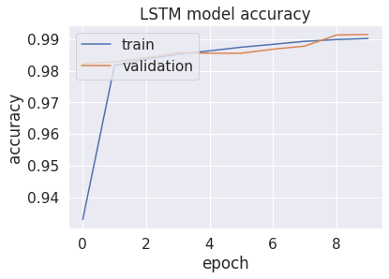

Slide 10
Proposed Algorithm
Multi-Layer Perceptron is used with 4 inputs and 6 outputs
Three Layers: input layer and One Hidden Layer with relu activation
And one output layer
Objective function is cross entropy
Cross validation 80% training 20% testing

Slide 11
Block Diagram
Normalization
Label Binarization
MLP
evaluation
input

Slide 12
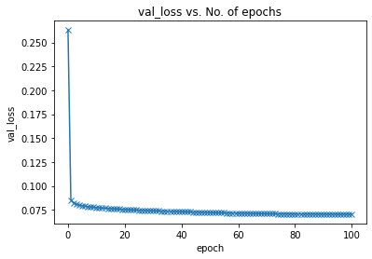
Results
100 epochs
Learning Rate 1e^-2
Minimum Loss reached: 0.0704

Slide 13
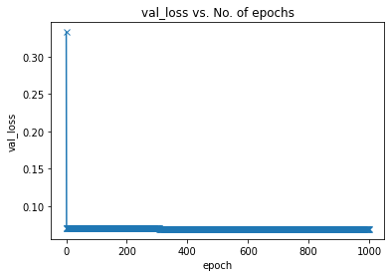
Results Cont’
Training for 1000 epochs
With learning rate of 1e^-3
Minimum Loss reached: 0.0695

Slide 14
Thank You

